Slide 1
ML Math-std-dev-var-percentile

Slide 2
Percentile (p1)
What is percentile ?
A percentile is a value below which a certain percentage of data falls. It shows the relative standing of a value within a dataset.
If you are in the 90th percentile of a test, it means you scored better than 90% of the people who took it.
What is a Percentage?
A percentage is just a number out of 100. It’s used to express proportions, comparisons, or scores.
If you scored 90% on a test, it means you got 90 out of 100 marks.

Slide 3
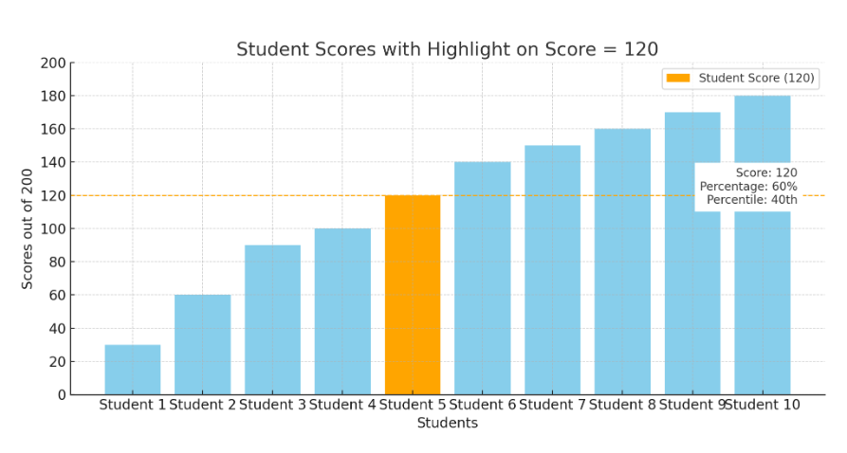
Percentile (p2)
Example1:
Let’s say 10 students took a test and got the following scores out of 200:
[30, 60, 90, 100, 120, 140, 150, 160, 170, 180]
Now let’s analyze a student who scored 120:
Percentage:
Since the test is out of 200, and the student scored 120:
Percentage (120/200)×100=60%
Percentile:
Count how many scores are less than 120:
Scores below 120 = [30, 60, 90, 100] → 4 students
Percentile =( 4/10 )×100=40th percentile
Even if your percentage is 60%, your percentile depends on how others performed — in this case, better-performing students pushed the percentile down.

Slide 4
Percentile (p2)
Example2:
Let's say 10 students took a test and got the following scores out of 100:
[45, 50, 55, 60, 65, 70, 75, 80, 85, 90]
Percentage of someone who scored 80 = 80%
Percentile of someone who scored 80 = They are above 8 out of 10 students → 80th percentile

